Slide 1


Slide 2
Contents
Introduction
Benefits of Generics
Generic Classes and Interfaces
Generic Methods

Slide 3
Introduction
Enables to create classes, interfaces, and methods in which the type of data upon which they operate is specified as a parameter.
Introduced in Java by jdk 1.5.
Generics means parameterized types.
Generics add the type-safety.
Generics add stability to your code by making more of your bugs detectable at compile time.

Slide 4
Why Generics?
The functionality of Gen class can be achieved without generics by specifying Object type and using proper casting whenever required.
Then why we use Generics?
Java compiler does not have knowledge about the type of data actually stored in NonGen. So-
Explicit casts must be employed to retrieve the stored data.
Several type mismatch errors cannot be found until run time.

Slide 5
Why Generics?
Stronger type checks at compile time
Elimination of casts
List list = new ArrayList(); list.add("hello");
String s = (String) list.get(0);
Using generics:
List<String> list = new ArrayList<String>(); list.add("hello");
String s = list.get(0); // no cast
Enabling programmers to implement generic algorithms.
We can implement generic algorithms that work on collections of different types, can be customized, and are type safe and easier to read.

Slide 6
Advantage of Generics
The ability to create type-safe code in which type-mismatch errors are caught at compile time is a key advantage of generics.

Slide 7
Example
class Gen<T> {
T ob;
Gen(T o)
{
ob = o;
}
T getob()
{
return ob;
}
void showType()
{
System.out.println("Type of T is " + ob.getClass().getName());
}
}

Slide 8
class GenDemo {
public static void main(String args[]) {
Gen<Integer> iOb;
iOb = new Gen<Integer>(88);
iOb.showType();
int v = iOb.getob();
System.out.println("value: " + v);
Gen<String> strOb = new Gen<String>("Generics Test");
strOb.showType();
String str = strOb.getob();
System.out.println("value: " + str);
} }

Slide 9
Generics Work Only with Objects
When declaring an instance of a generic type, the type argument passed to the type parameter must be a class type.
Gen<int> strOb = new Gen<int>(53);
The above declaration is an error.
A reference of one specific version of a generic type is not type compatible with another version of the same generic type.
iOb = strOb; // Wrong!

Slide 10
Generic Class

Slide 11
General Form of Generic Class
The generics syntax for declaring a generic class:
class class-name<type-param-list>
{ // ... }
The syntax for declaring a reference to a generic class:
class-name<type-arg-list> var-name =
new class-name<type-arg-list>(cons-arg-list);

Slide 12
Generic Class with Multiple Type Parameters
class TwoGen<T, V> {
T ob1; V ob2;
TwoGen(T o1, V o2) {
ob1 = o1; ob2 = o2; }
void showTypes() {
System.out.println("Type of T is " + ob1.getClass());
System.out.println("Type of V is " +
ob2.getClass()); }
T getob1() { return ob1; }
V getob2() { return ob2; }
}

Slide 13
class SimpGen {
public static void main(String args[]) {
TwoGen<Integer, String> t =
new TwoGen<Integer, String>(123, "Testing Two Parameter");
t.showTypes();
int v = t.getob1();
System.out.println("value: " + v);
String str = t.getob2();
System.out.println("value: " + str);
}
}

Slide 14
Problem
Create a generic class that contains a method that returns the average of an array of numbers of any type, including integers, floats, and doubles.

Slide 15
Possible Solution
class Stats<T> {
T[] nums;
Stats(T[] o) {
nums = o;
}
double average() {
double sum = 0.0;
for(int i=0; i < nums.length; i++)
sum += nums[i].doubleValue(); // Error!!!
return sum / nums.length;
}
}

Slide 16
Why Error?
The compiler has no way to know that you are intending to create Stats objects using only numeric types.
When we try to compile Stats, an error is reported that indicates that the doubleValue( ) method is unknown.
We need some way to tell the compiler that we intend to pass only numeric types to T.

Slide 17
Bounded Types
Used to limit the types that can be passed to a type parameter.
When specifying a type parameter, we can create an upper bound that declares the super-class from which all type arguments must be derived.
<T extends superclass>
A bound can include both a class type and one or more interfaces.
class Gen<T extends MyClass & MyInterface>
Any type argument passed to T must be a subclass of MyClass and implement MyInterface.

Slide 18
WILD CARD GenericS

Slide 19
Problem
Create a generic class that contains a method sameAvg( ) that determines if two Stats objects contain arrays that yield the same average, no matter what type of numeric data each object holds.
For example, if one object contains the double values 1.0, 2.0, and 3.0, and the other object contains the integer values 2, 1, and 3, then the averages will be the same.

Slide 20
Possible Solution
Integer inums[] = { 1, 2, 3, 4 }; Double dnums[] = { 1.1, 2.2, 3.3, 4.4 };
Stats<Integer> iob = new Stats<Integer>(inums);
Stats<Double> dob = new Stats<Double>(dnums);
if(iob.sameAvg(dob))
System.out.println("Averages are the same.");
else
System.out.println("Averages differ.");
boolean same_Avg(Stats<T> ob)
{
if(average() == ob.average())
return true;
return false;
}

Slide 21
Why Error?
It will work only with the objects of same type.
if the invoking object is of type Stats<Integer>, then the parameter ob must also be of type Stats<Integer>.

Slide 22
WildCard Argument
The wildcard simply matches the validity of object.
The wildcard argument is specified by the ?, and it represents an unknown type.
boolean same_Avg(Stats<?> ob)
{
if(average() == ob.average())
return true;
return false;
}
.
Here, Stats<?> matches any Stats object, allowing any two Stats objects to have their averages compared

Slide 23
Generic Method

Slide 24
Generic Method
It is possible to declare a generic method that uses one or more type parameters.
Methods inside a generic class are automatically generic relative to the type parameters.
It is possible to create a generic method that is enclosed within a non-generic class.

Slide 25
Generic Methods
The type parameters are declared before the return type of the method.
Generic methods can be either static or non-static.
<type-param-list> ret-type method-name(param-list) {…}
Example:
static <T, V extends T> boolean isIn (T x, V[] y)
This ability to enforce type safety is one of the most important advantages of generic methods.

Slide 26
Generic Constructors

Slide 27
Generic Constructors
It is possible for constructors to be generic, even if their class is not.
Example:
class GenCons
{
private double val;
<T extends Number> GenCons(T arg)
{
val = arg.doubleValue();
}
}
}

Slide 28
// Use a generic constructor.
class GenCons {
private double val;
<T extends Number> GenCons(T arg) {
val = arg.doubleValue();
}
void showval() {
System.out.println("val: " + val);
}
}
class GenConsDemo {
public static void main(String args[]) {
GenCons test = new GenCons(100);
GenCons test2 = new GenCons(123.5F);
test.showval();
test2.showval();
}
}
Note: Because GenCons( ) specifies a parameter of a generic type, which must be a subclass of Number, GenCons( ) can be called with any numeric type, including Integer, Float, or Double.

Slide 29
Java Collections FrameWork

Slide 30
A data structure is a collection of data organized in some fashion. The structure not only stores data but also supports operations for accessing and manipulating the data.
Java provides various data structures that can be used to organize and manipulate data efficiently. These data
structures are commonly known as Java Collections Framework.
java.util package contains all the collection classes and interfaces.
In object-oriented thinking, a data structure, also known as a container, is an object that stores other objects, referred to as data or elements.

Slide 31
Advantages of Collections
Reduces programming effort
Increases program speed and quality
Allows interoperability among unrelated APIs

Slide 32
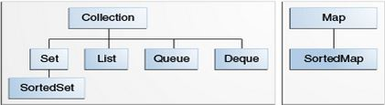
Collection Interfaces
The Java Collections Framework supports two types of containers:
Collection: for storing a collection of elements
Map: for storing key/value pairs

Slide 33
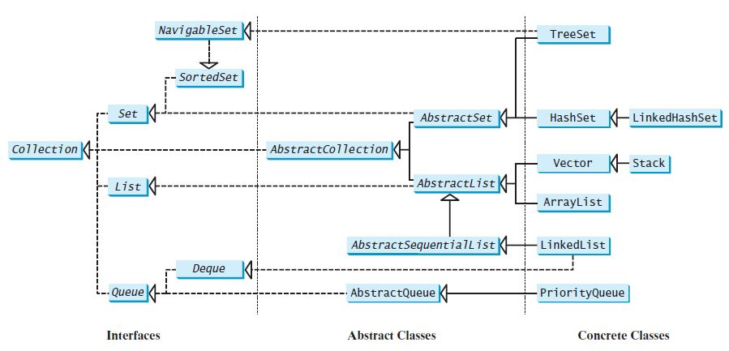

Slide 34
Collection Interfaces
Sets store a group of non-duplicate elements.
Lists store an ordered collection of elements.
Queues store objects that are processed in first-in, first-out fashion.
Maps are efficient data structures for quickly searching an element using a key.

Slide 35
The AbstractCollection class provides partial implementation for the Collection interface.
It implements all the methods in Collection except the size() and iterator() methods.

Slide 36
Collection
Interface

Slide 37
Methods of Collection Interface
boolean add(Object o)
Appends the specified element o to the end of the collection.
boolean addAll(Collection c )
Appends all of the elements in the specified collection to the end of the collection.

Slide 38
boolean contains(Object o)
Returns true if this list contains the specified element.
boolean containsAll(Collection c)
Returns true if this collection contains all the elements in c.

Slide 39
boolean remove(Object o)
Removes the object from this collection.
boolean removeAll(Collection c)
Removes all the elements in c from this collection.
boolean retainAll(Collection c)
Retains the elements that are both in c and in this collection.

Slide 40
void clear()
Removes all of the elements from the collection.
boolean isEmpty()
Returns true if this collection contains no elements.
int size()
Returns the number of elements in the collection.

Slide 41
object [] toArray()
Returns an array of Object for the elements in the collection.
int hashCode()
Returns the hash code for the collection.
Iterator iterator()
Returns the iterator object for the invoking collection.
        I

Slide 42
Practice MCQs
Which interface restricts duplicate elements?
Set
List
Map
All of these
Which does NOT inherit the Collection interface?
List
Map
Set
None of these

Slide 43
Practice MCQs
Deque and Queue are derived from:
A. AbstractList
B. Collection
C. AbstractCollection
D. List
The root interface of Java Collection framework hierarchy is -
A. Collection
B. List
C. Collections
D. Set

Slide 44
Practice MCQs
LinkedList class implements?
A.Deque
B.List
C.Both A and B
D.None of these

Slide 45
Iterators

Slide 46
Iterator
There is an Iterable interface at the top of Collection hierarchy.
The Collection interface extends the java.lang.Iterable interface.
It defines a method which returns an Iterator object for the elements of Collection.
Iterator iterator()
Iterator object is used to traverse the elements in a collection.

Slide 47
Methods of Iterator Interface
boolean hasNext()
Returns true if this iterator has more elements to traverse.
Object next()
Returns the next element from this iterator.
void remove()
Removes the last element obtained using the next method.

Slide 48
ListIterator

Slide 49
ListIterator
ListIterator is derived from Iterator interface and comes with more methods than Iterator.
ListIterator can be used to traverse for List type Objects.
Allows to traverse in both the directions.

Slide 50
ListIterator
A ListIterator has no current element; its cursor position always lies between the element that would be returned by a call to previous() and the element that would be returned by a call to next().
The remove() and set(Object) methods are not defined in terms of the cursor position; they are defined to operate on the last element returned by a call to next() or previous().

Slide 51
ListIterator Methods
public abstract boolean hasPrevious()
public abstract Object previous();
public abstract int nextIndex();
public abstract int previousIndex();
public abstract void set(Object);
public abstract void add(Object);

Slide 52
list Interface

Slide 53
List
The List interface extends the Collection interface.
It defines a collection for storing elements in a sequential order.
It define an ordered collection with duplicates allowed.
ArrayList , Vector and LinkedList are the sub-classes of List interface.

Slide 54
Methods of List Interface
boolean add(int index, Object o )
boolean addAll(int index, Collection c )
Object remove(int index)
Object get(int index)
Object set(int index, Object o)
int indexOf(Object o)
int lastIndexOf(Object o)
ListIterator listIterator()
ListIterator listIterator(int start_index)
List subList(int start_index, int end_index): returns a sublist from start_index to end_index-1

Slide 55
Sub-classes of List
ArrayList
LinkedList
Vector
Stack

Slide 56
ArrayList

Slide 57
ArrayList
The ArrayList class extends AbstractList and implements the List interface.
Defined in java.util package.
ArrayList supports dynamic arrays that can grow as needed.
Array lists are created with an initial size.
When this size is exceeded, the collection is automatically enlarged.
When objects are removed, the array may be shrunk.

Slide 58
ArrayList Constructors
The ArrayList class supports three constructors.
ArrayList() : creates an empty array list with an initial capacity sufficient to hold 10 elements.
ArrayList(int capacity) : creates an array list that has the specified initial capacity.
ArrayList(Collection c) : creates an array list that is initialized with the elements of the collection c.

Slide 59
Methods of ArrayList
boolean add(Object o)
Appends the specified element to the end of this list.
void add(int index, Object element)
Inserts the specified element at the specified position index in this list.
Throws IndexOutOfBoundsException if the specified index is out of range.

Slide 60
boolean addAll(Collection c )
Appends all of the elements in the specified collection to the end of this list.
Throws NullPointerException if the specified collection is null.
boolean addAll(int index, Collection c )
Inserts all of the elements of the specified collection into this list, starting at the specified position.
Throws NullPointerException if the specified collection is null.

Slide 61
Object remove(int index)
Removes the element at the specified position in this list.
Object remove(Object o)
Removes the element o from this list.
Object clone()
Returns a shallow copy of this ArrayList.
int size()
Returns the number of elements in the list.
void clear()
Removes all of the elements from this list.

Slide 62
boolean contains(Object o)
Returns true if this list contains the specified element.
Object get(int index)
Returns the element at the specified position in this list.
int indexOf(Object o)
Returns the index in this list of the first occurrence of the specified element, or -1 if the List does not contain the element.
int lastIndexOf(Object o)
Returns the index in this list of the last occurrence of the specified element, or -1.

Slide 63
void ensureCapacity(int minCapacity)
Increases the capacity of this ArrayList instance, if necessary, to ensure that it can hold at least the number of elements specified by the minimum capacity argument.
Object set(int index, Object element)
Replaces the element at the specified position in this list with the specified element.
Throws IndexOutOfBoundsException if the specified index is out of range (index < 0 || index >= size()).

Slide 64
void trimToSize()
Trims the capacity of this ArrayList instance to be the list’s current size.

Slide 65
Set Interface

Slide 66
Set Interface
A set is an efficient data structure for storing and processing non-duplicate elements.
Set does not introduce new methods or constants.
The sub-classes of Set (HashSet, TreeSet & LinkedHashSet) ensure that no duplicate elements can be added to the set.

Slide 67
Set Interface
The AbstractSet class provides implementations for the equals() method and the hashCode().
The hash code of a set is the sum of the hash codes of all the elements in the set.
The size() and iterator() are not implemented in the AbstractSet class.

Slide 68
SortedSet Interface
SortedSet is a subinterface of Set, which guarantees that the elements in the set are sorted.
It provides the methods first() and last() for returning the first and last elements in the set.
headSet(toElement) and tailSet(fromElement) for returning a portion of the set whose elements are less than toElement and greater than or equal to fromElement.

Slide 69
NevigableSet Interface
NavigableSet extends SortedSet.
It provides navigation methods lower(e), floor(e), ceiling(e), and higher(e) that return elements respectively less than, less than or equal, greater than or equal, and greater than a given element and return null if there is no such element.
The pollFirst() and pollLast() methods remove and return the first and last element in the tree set, respectively.

Slide 70
TREESet

Slide 71
TreeSet
TreeSet implements the NavigableSet interface.
We can add objects into a tree set as long as they can be compared with each other.
Access and retrieval times are quite fast.

Slide 72
TreeSet
Constructor:
TreeSet()
TreeSet(Collection c)
TreeSet(Comparator c)

Slide 73
Comparator Interface
java.util.Comparator interface provides two abstract methods:
public interface Comparator<T>
{
public abstract int compare(T ob1, T ob2);
public abstract boolean equals(java.lang.Object);
…
}

Slide 74
Comparable Interface
java.lang.Comparable interface provides only one abstract method:
public interface Comparable<T>
{
public abstract int compareTo(T ob);
}

Slide 75
Implementing TreeSet
import java.util.*;
public class SortSetExample {
public static void main(String...rk){
Set<Integer> tree = new TreeSet<Integer>();
tree.add(3);
tree.add(1);
tree.add(2);
System.out.println("treeSet : "+treeSet);
}
}

Slide 76
Implementing TreeSet with Comparator sorting in descending order
import java.util.*;
public class SortSetExample {
public static void main(String...rk){
Set<Integer> tree = new TreeSet<Integer>(new Comparator<Integer>() {
public int compare(Integer o1, Integer o2) {
return o2.compareTo(o1);
}
});
tree.add(3); tree.add(1); tree.add(2);
System.out.println("treeSet : "+tree);
}
}

Slide 77
Implementing TreeSet with Comparable
import java.util.*;
class Employee implements Comparable<Employee>{
String name; String id;
public Employee(String name, String id) {
this.name = name; this.id = id;
}
public int compareTo(Employee otherEmployee) {
return this.name.compareTo(otherEmployee.name);
}
public String toString() {
return "Employee{" + "name=" + name + ", id=" + id + '}';
}
}

Slide 78
Implementing TreeSet with Comparable sorting in ascending order
public class SortSetExample {
public static void main(String...a){
Employee emp1=new Employee("sam","4");
Employee emp2=new Employee("amy","2");
Employee emp3=new Employee("brad","1");
Set<Employee> treeSet = new TreeSet<Employee>();
treeSet.add(emp1);
treeSet.add(emp2);
treeSet.add(emp3);
System.out.println("treeSet : "+treeSet);
}
}

Slide 79
Implementing TreeSet with Custom Objects using Comparator
class Employee{
String name;
String id;
public Employee(String name, String id) {
this.name = name; this.id = id;
}
public String toString() {
return "Employee{" + "name=" + name + ", id=" + id + '}';
}
}

Slide 80
Implementing TreeSet with Custom Objects using Comparator
public class SortSetExample {
public static void main(String...a){
Employee emp1=new Employee("sam","4");
Employee emp2=new Employee("amy","2");
Employee emp3=new Employee("brad","1");
Set<Employee> treeSet = new TreeSet<Employee>(new Comparator<Employee>() {
public int compare(Employee o1, Employee o2) { return o1.name.compareTo(o2.name); }
});
treeSet.add(emp1); treeSet.add(emp2); treeSet.add(emp3);
System.out.println("treeSet : "+treeSet);
}}

Slide 81
DEQueue

Slide 82
Deque Interface
Deque supports element insertion and removal at both ends.
The name deque is short for “double-ended queue” and is usually pronounced “deck.”
The Deque interface extends Queue with additional methods for inserting and removing elements from both ends of the queue.
The methods addFirst(e), removeFirst(), addLast(e), removeLast(), getFirst(), and getLast() are defined in the Deque interface.

Slide 83
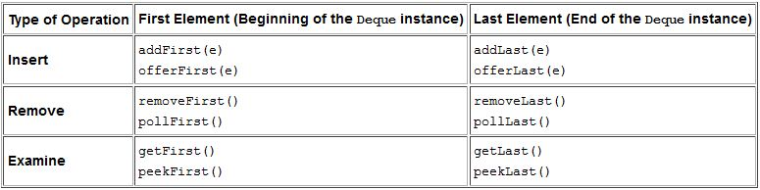
Deque Methods

Slide 84
Insert Methods
The addfirst and offerFirst methods insert elements at the beginning of the Deque instance.
The methods addLast and offerLast insert elements at the end of the Deque instance.
When the capacity of the Deque instance is restricted, the preferred methods are offerFirst and offerLast because addFirst might fail to throw an exception if it is full.

Slide 85
Remove Methods
removeFirst and pollFirst methods remove elements from the beginning of the Deque.
The removeLast and pollLast methods remove elements from the end.
The methods pollFirst and pollLast return null if the Deque is empty whereas the methods removeFirst and removeLast throw an exception if the Deque instance is empty.

Slide 86
Retrieve Methods
getFirst and peekFirst retrieve the first element but don’t remove the value from the Deque.
Similarly, getLast and peekLast retrieve the last element.
The methods getFirst and getLast throw an exception if the deque instance is empty whereas the methods peekFirst and peekLast return NULL.

Slide 87
Deque Implementation
The ArrayDeque class is the resizable array implementation of the Deque interface, whereas the LinkedList class is the list implementation.
The LinkedList is more flexible than the ArrayDeque as null elements are allowed in the LinkedList implementation but not in ArrayDeque.
ArrayDeque is more efficient than the LinkedList for add and remove operation at both ends.
The best operation in a LinkedList implementation is removing the current element during the iteration.

Slide 88
ArrayDeque Constructors
ArrayDeque()
Constructs an empty array deque with an initial capacity sufficient to hold 16 elements.
ArrayDeque(Collection<? extends E> c)
Constructs a deque containing the elements of the specified collection, in the order they are returned by the collection's iterator.
ArrayDeque(int numElements)
Constructs an empty array deque with an initial capacity sufficient to hold the specified number of elements.

Slide 89
LinkedList Constructors
LinkedList()
Constructs an empty LinkedList.
LinkedList(Collection<? extends E> c)
Constructs a list containing the elements of the specified collection, in the order they are returned by the collection's iterator.

Slide 90
MAP Interface

Slide 91
MAP Interface
A map is a container object that stores a collection of key/value pairs.
Keys are like indexes in List but in Map, the keys can be any objects.
A map cannot contain duplicate keys.
Each key maps to one value.
A key and its corresponding value form an entry stored in a map.

Slide 92
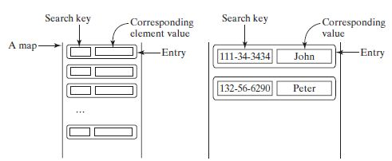
MAP

Slide 93
MAP Methods
int size()
void clear()
boolean isEmpty()
V put( K key, V value)
void putAll( m: Map<? extends K,? extendsV>)
boolean containsKey (Object key)
boolean containsValue(Object value)
V get(Object key)
Set<K> keySet()
V remove( Object key)
Collection <V> values()
Set<Map.Entry<K,V>> entrySet()

Slide 94
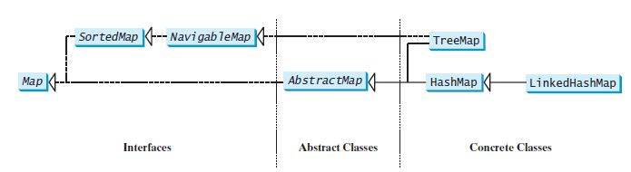
MAP Class Hierarchy

Slide 95
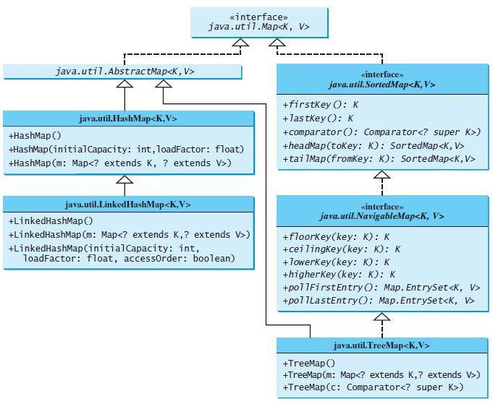
MAP
Ravi Kant Sahu, Asst. Professor @ Lovely Professional University, Punjab (India)

Slide 96
HashMap
The HashMap class is efficient for locating a value, inserting an entry, and deleting an entry.
The entries in a HashMap are not ordered.
public class HashMap<K, V> extends AbstractMap<K, V> implements Map<K, V>, Cloneable, Serializable

Slide 97
HashMap
Constructors:
HashMap()
Constructs an empty HashMap with the default initial capacity (16) and the default load factor (0.75).
HashMap(int initialCapacity)
Constructs an empty HashMap with the specified initial capacity and the default load factor (0.75).
HashMap(int initialCapacity, float loadFactor)
Constructs an empty HashMap with the specified initial capacity and load factor.
HashMap(Map<? extends K,? extends V> m)
Constructs a new HashMap with the same mappings as the specified Map.

Slide 98
Let’s Do It?
Given an array containing int values and find out the numbers which occur exactly 2 times.
Example: arr = {1, 3, 4, 3, 1, 1, 2, 3, 2, 4, 5};
Output: 4, 2

Slide 99
Let’s Do It?
WAP to implement a method which accepts an arraylist containing duplicate values and returns a Collection having unique elements only.
public Collection revoveDuplicate(ArrayList<T extends Number> al)

Slide 100
Let’s Do It?
WAP to create a class Student with attributes name and cgpa. Add at least 5 Student objects in an appropriate collection such that they are sorted in descending order on the basis of their cgpa.
Display the names of all the students who are eligible for Verizon placement drive. (Eligibility: cgpa >=7.5 )

Slide 101
LinkedHashMap
LinkedHashMap extends HashMap with a linked-list implementation that supports an ordering of the entries in the map.
The entries in a LinkedHashMap can be retrieved in two orders:
1. Order in which they were inserted into the map (insertion order)
2. In the order in which they were last accessed, from least recently to most recently accessed (access order).

Slide 102
LinkedHashMap
The no-arg constructor constructs a LinkedHashMap with the insertion order.
To construct a LinkedHashMap with the access order, use
LinkedHashMap(initialCapacity, loadFactor, true)

Slide 103
TreeMap
The TreeMap class is efficient for traversing the keys in a sorted order.
The keys can be sorted using the Comparable interface or the Comparator interface.

Slide 104
TreeMap
If we create a TreeMap using its no-arg constructor, the compareTo method in the Comparable interface is used to compare the keys in the map.
To use a comparator, we have to use the
TreeMap(Comparator comparator)
constructor to create a sorted map that uses the compare method in the comparator to order the entries in the map based on the keys.

Slide 105
SortedMap
SortedMap is a subinterface of Map, which guarantees that the entries in the map are sorted.
It provides the following methods:
  firstKey() and lastKey() for returning the first and last keys in the map
  headMap(toKey) and tailMap(fromKey) for returning a portion of the map whose keys are less than toKey and greater than or equal to fromKey.

Slide 106
NavigableMap
NavigableMap extends SortedMap.
It provides the following navigation methods:
  lowerKey(key)
  floorKey(key)
  ceilingKey(key)
  higherKey(key)
  return keys respectively less than, less than or equal, greater than or equal, and greater than a given key and return null if there is no such key.
The pollFirstEntry() and pollLastEntry() methods remove and return the first and last entry in the tree map, respectively.

Slide 107


